Slide 1
Ecology Review

Slide 2
Picture 1
a) What type of ecosystem is this? Explain how you know.
b) Where does energy come from? List 2 sources.
c) Identify 2 biotic factors.
d) Identify 2 abiotic factors.
e) Make a food chain with 1 producer, 2 consumers, and 1 decomposer. f) What would happen if the trees died? g) What would happen if the bird died?

Slide 3
Picture 2
a)What are 2 abiotic factors in this ecosystem? b) What are 2 biotic factors in this ecosystem? c)Give an example of a carnivore. Explain how you know. d)Give an example of an omnivore. Explain how you know. e)Give an example of a detritivore. Explain how you know.

Slide 4
http://tx.english-ch.com/teacher/owen/level-c/amazing-icebergs-and-their-role-in-the-ecosystem/
Picture 3
a) Give 3 examples of populations
b) Give 1 example of a community c) Give 1 example of a habitat d) Define ecosystem e) Identify 1 producer, 1 consumer, and 1 decomposer

Slide 5
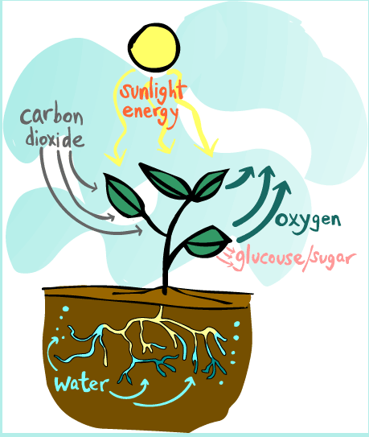
Picture 4
a) What process does this picture show? b) Where does it happen? c) What organism does it? d) What kind of energy is produced? e) Where does the O2 go?

Slide 6
Picture 5
a) What process does this picture show? b) What 3 things do plants use? c) What 2 things do plants make? d) How is the sugar used…
-by the plant? -by other animals? e) What kinds of organisms do photosynthesis? Explain why.

Slide 7
Picture 6
a)This is a picture of a food web. What do the lines show? b) Is there a producer in this picture? Explain how you know. c) Is there a decomposer in this picture? Explain how you know. d) What would happen to the dragonflies if the salamander died? Explain why. e) What would happen to the eagle if the salamander died? Explain why.

