Slide 1
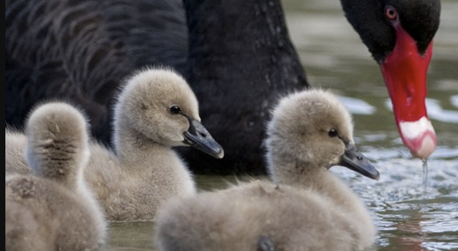
Instructions for Speaking test
Person 1: Describe what you see. Use nouns, verbs, adjectives and specific vocabulary words.
Person 2: Help your partner by asking questions.
For example:
1) Who do you see?
2) What are they doing?
3) Where are they?
4) When was this picture taken?
5) Why are they doing this?
6) How does this picture make you feel? Why?
7) What happened before?
8) What will happen next?
Level 1: Questions 1- 3
Level 3: Questions 1-5
Level 5: Questions 1-8

Slide 2
Say: ESL 103 Speaking Test #1
My name is _____.
My partner is ______.
Today is (date)

Slide 3

Practice 1: Describe the picture below.

Slide 4
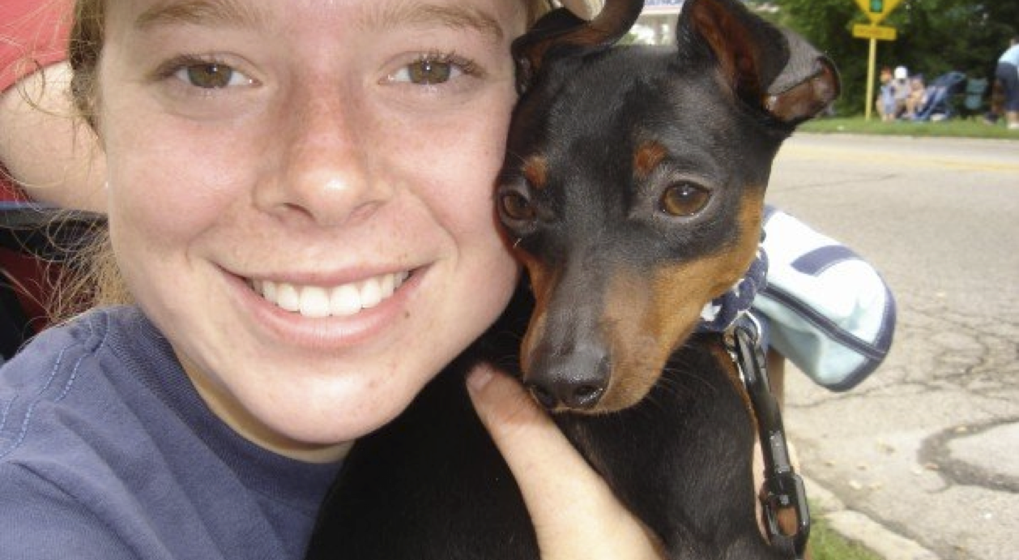
Practice 2: Describe the picture below.

Slide 5
Demo video link
http://www.screencast.com/t/Bav3zpZB

