Slide 1
Examples of Ecosystems

Slide 2
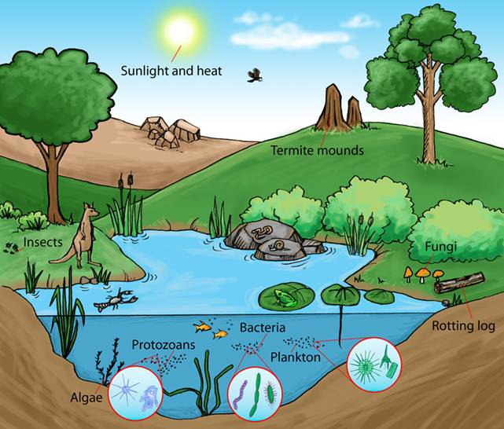

Slide 3
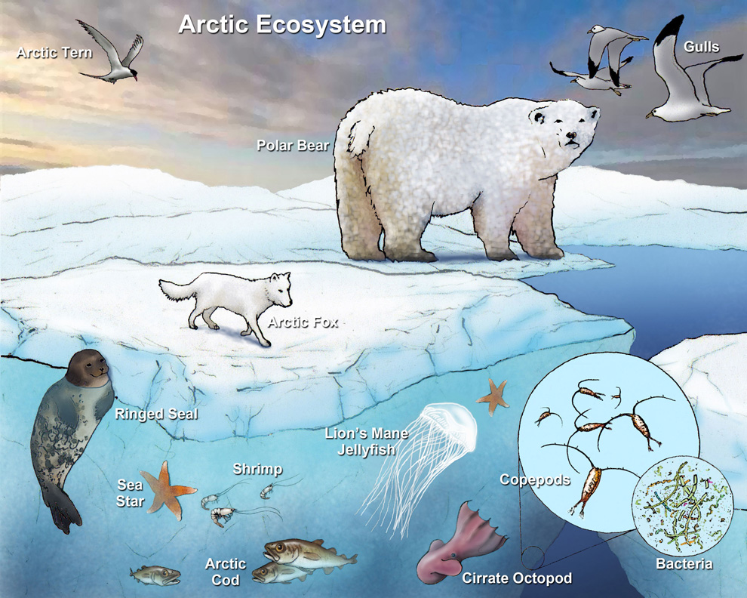

Slide 4
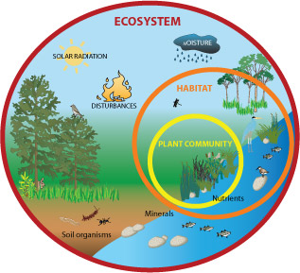
http://tx.english-ch.com/teacher/owen/level-c/amazing-icebergs-and-their-role-in-the-ecosystem/

