Slide 1
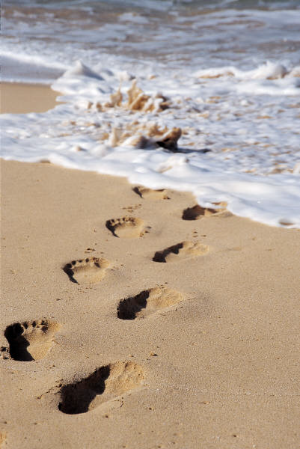
Travel Journal Assignment
ESL 103 Mrs. Hutchison

Slide 2
What is a travel journal?
A travel journal is a written record of your experiences on a journey or trip.
You will each be making a travel journal about your journey as a student.
Keyword: Journal

Slide 3
What should it include?
This travel journal will use mixed-media:
Pictures
drawings,
poems,
newspaper articles,
written reflections,
music lyrics, etc.)
Because we live in a technology age you will need to use the computer for at least part of your journal. You can use it to help you translate, find resources, or even keep an online portfolio. Your privacy is important so only share it with our class.
Make it interesting!

Slide 4
How will I be graded?
You will be graded based on a rubric. The rubric will include sections for:
1) Mixed Media 2) Correct use of the past tense of the verbs “be”, “go” and “have” 3) Descriptions of the artifacts you have chosen with various nouns, verbs, and adjectives from our class list. 4) Citations of your media sources

Slide 5
What are some examples?
Free Online travel journal sites:
http://www.travelpod.com/ http://www.mytripjournal.com/
http://www.travbuddy.com/
Printables:
http://www.pinterest.com/lilith_phlox/travel-journal-printables/

Slide 6
To do today:
Make a list of interview questions you will ask a family member or guardian about a journey they have taken. Class goal: 10-15 questions Use: Who/what/where/when/why/how in your questions.

