Slide 1
THINKING BIG, WORKING SMALL

Slide 2
Opportunity
The world is changing, and with change comes opportunity.
Notes:
Today’s manufacturing methods are very crude at the molecular level. Casting, grinding, milling and even lithography move atoms in great thundering statistical herds. It's like trying to make things out of LEGO blocks with oven mitts on your hands. Yes, you can push the LEGO blocks into great heaps and pile them up, but you can't really snap them together the way you'd like.

Slide 3
Think Back …
Consider the beginning of the 1900’s, what invention or product transformed almost every aspect of the American life?
In your group, take a few minutes to come up with a couple of ideas that fit this description.

Slide 4
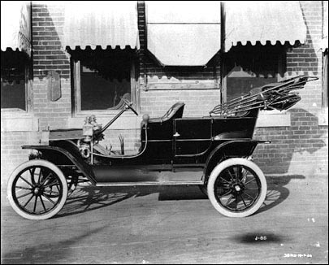
Along Comes the Car
1908
Cost = $5000 or $108,000 in today’s dollars

Slide 5
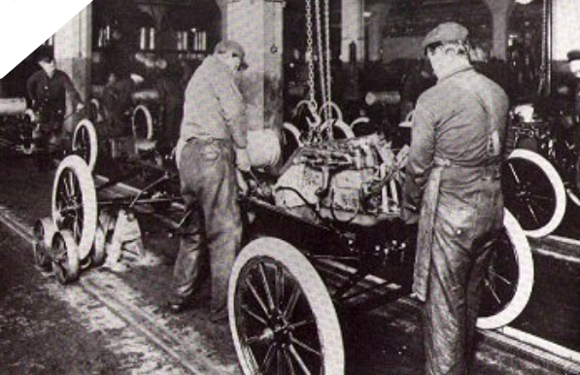
Introduce the Assembly Line
1914
Cost = $850 or $18,000 in today’s dollars

Slide 6
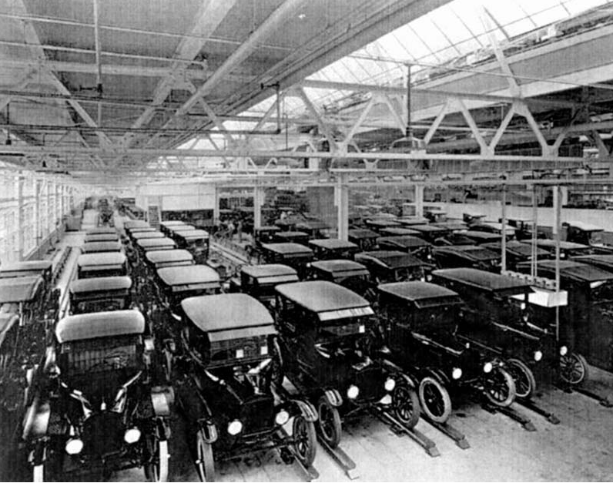
Disruptive technologies …
1925
The Automobile
Cost = $360 or $8,000 in today’s dollars
The result → affordable transportation for anyone
Notes:
Using a 'push' moving assembly line and interchangeable parts, Henry Ford was able to mass produce his Model T's and sell them for just $850. This was less than a wagon and team of horses cost. In 1913 Henry Ford replaced his 'push' moving assembly line with a conveyor belt assembly line. This way was eight times faster because now the model T mechanically moved through each station instead of by hand. By 1925 the Ford Company was able to complete a new car every ten seconds. The Model T's low price allowed everyone that was making a good salary to buy a car. That same year the price had dropped to $360.00.
Henry Ford combined precision manufacturing, standardized and interchangeable parts, a division of labor, and, in 1913, a continuous moving assembly line. Workers remained in place, adding one component to each automobile as it moved past them on the line. Delivery of parts by conveyor belt to the workers was carefully timed to keep the assembly line moving smoothly and efficiently. The introduction of the moving assembly line revolutionized automobile production by significantly reducing assembly time per vehicle, thus lowering costs.
The automobile assembly line forever changed manufacturing. Identifying and componentizing work processes produced a ten-fold increase in production, quality, and profitability.
This was modern mass production, the single most important factor in making America the economic and military powerhouse of the 20th century.
Ford's system of belt-driven assembly line production is arguably the most important innovation of the Industrial Age. Ford, in fact, coined the word, "mass production."
Before the assembly line, it took 13 hours to make a car. Soon it took less than an hour. By saving time, Ford saved money and drove down the price of his car nearly every year. The last Model T, built in 1927, cost a mere $290.

Slide 7
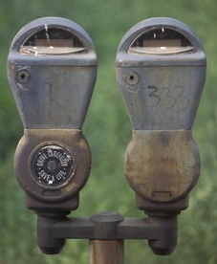
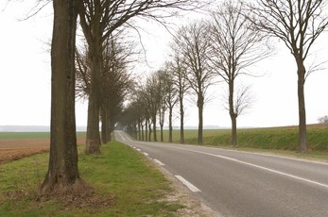
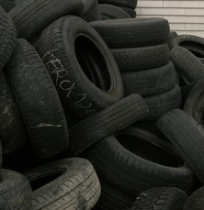
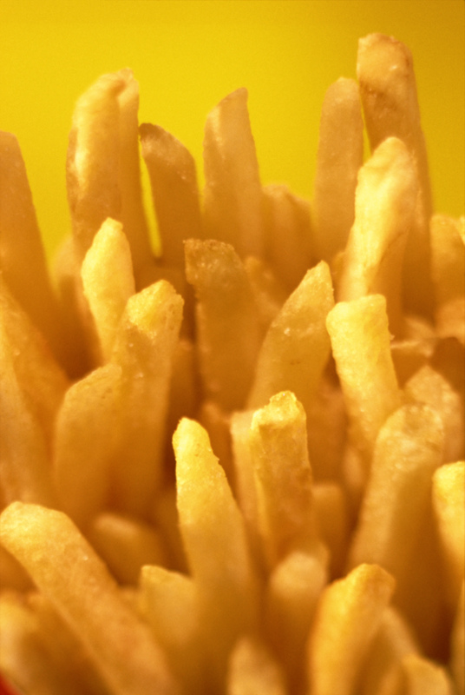
… change everything
Notes:
Work changed
People became more independent
People traveled
People spent money differently
People expected more features
Cars had more parts
To remain cost-effective, processes and tools needed to change

Slide 8
Any others?
Can you think of any other “disruptive technologies” that have come along in the last 100 years?
Will nanotechnology be the next?

Slide 9
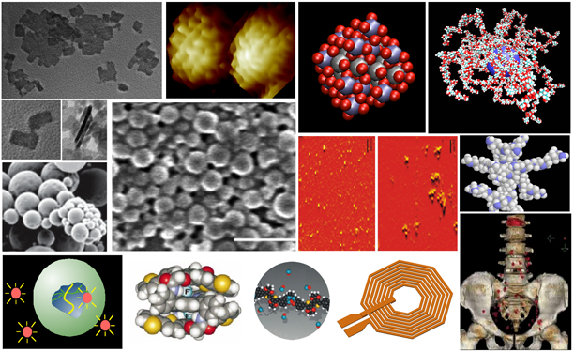
What is nanotechnology?
Nanotechnology - The manipulation of matter at the molecular or atomic level

Slide 10
How small is nano really!
Let’s head to the hall to try to conceptualize the scale we are talking about here!
So, if someone asked you how big is a nanometer, what would you say?

Slide 11
Nanoscale

Slide 12
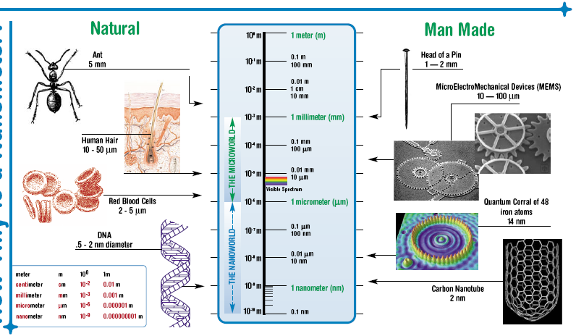
Even more Nanoscale examples

Slide 13
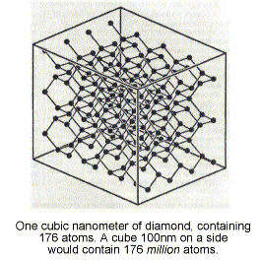
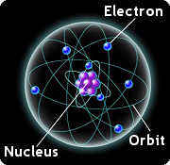
Nanoscale & the Atom
Carbon Atoms
~1 nanometer (nm)

Slide 14
More ways to “see” the nanoscale
Other ways to conceptualize the nanoscale
Volume (Nano Car) – (1:10)
Scale from Light Years to Nanoscale – (1:50)

Slide 15
Nanotechnology - Infusing all the sciences
*From Seigel

Slide 16
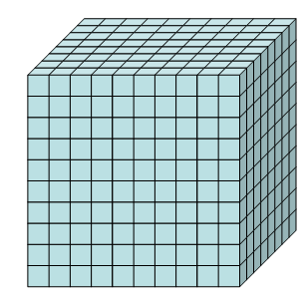
Why do things change at the nanoscale?
BULK properties evident when the object is large
What is the surface area?
What is the volume?
Surface = 600 units
Volume = 1000 units
SURFACE properties evident when an object is very small
What is the surface area?
What is the volume?
Surface = 6 units
Volume = 1 unit

Slide 17
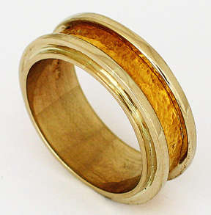
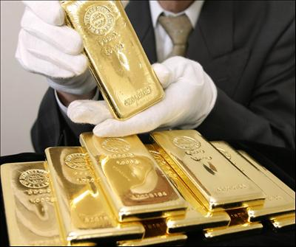
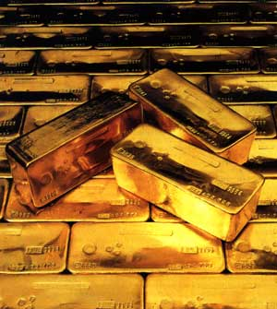
Color at this size
What color are these?
Take a look at my sample to see if you notice any differences.

Slide 18
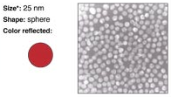
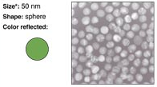
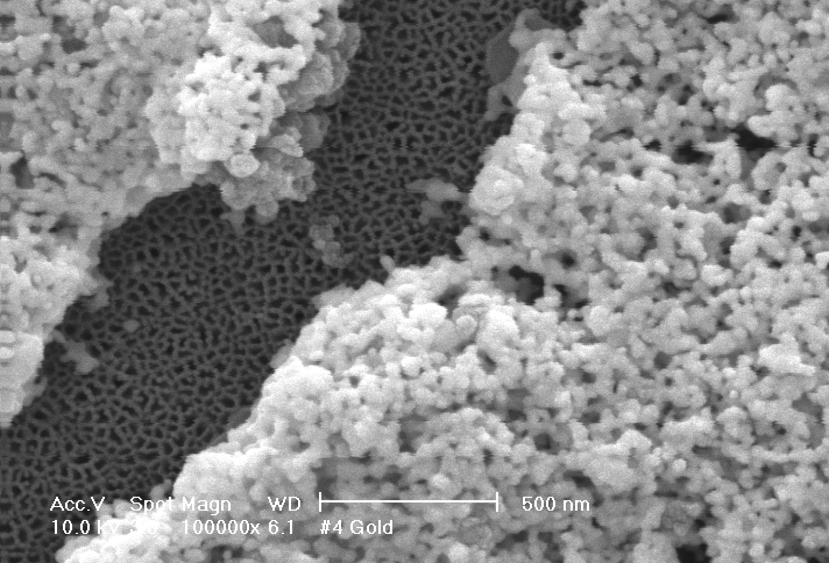
Why So Small (part1)?
Nano particles of gold – take on a different color at different sizes
Substances take on different properties at nanoscale.
Working at the nanoscale allows us to change the properties of products.

Slide 19
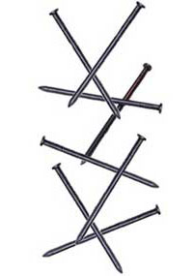
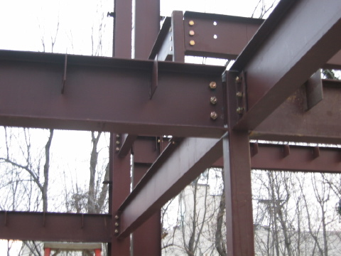
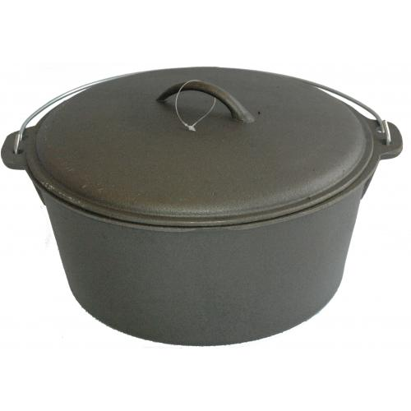
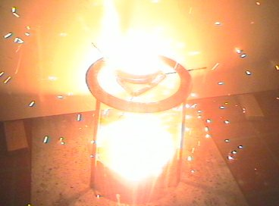
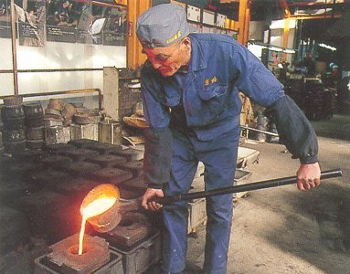
States of Matter at this size
How would you describe iron?
How would you make iron into a liquid?

Slide 20
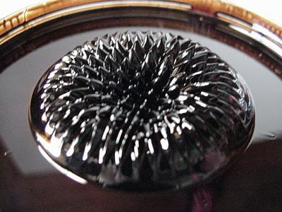
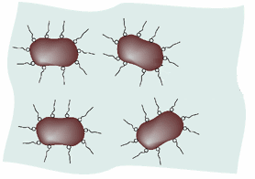
Why so small (part 2)?
Ferrofluid
Normal iron particles settle out of a liquid
Tiny iron particles (only 10 nm) can remain mixed in liquid
Used in electronics, speakers, and even bridge building

Slide 21
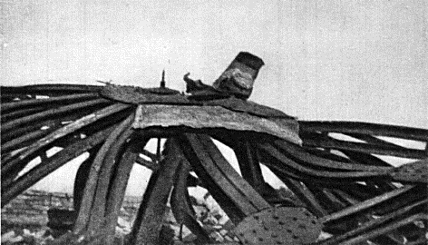
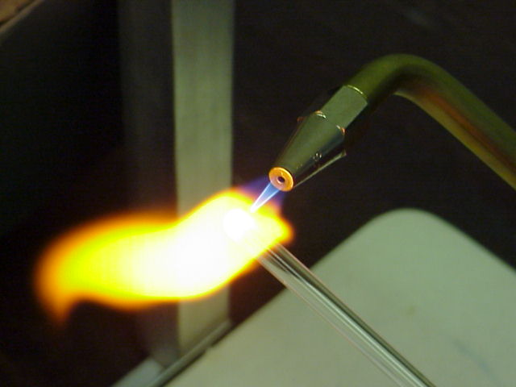
Shape of Matter
How can you return a metal to its original shape?
Heat
It
Bend
It
Drop it into a cup of coffee?

Slide 22
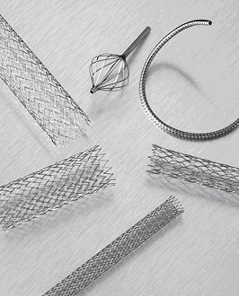
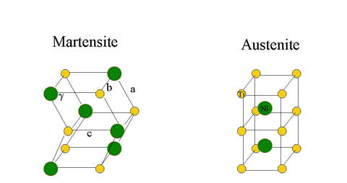
Why so small (part 3)?
Nitinol – referred to as “memory metal” is an alloy that "remembers" its geometry. When heated it returns to its original state.
So, how can we use it?
Nitinol states

Slide 23
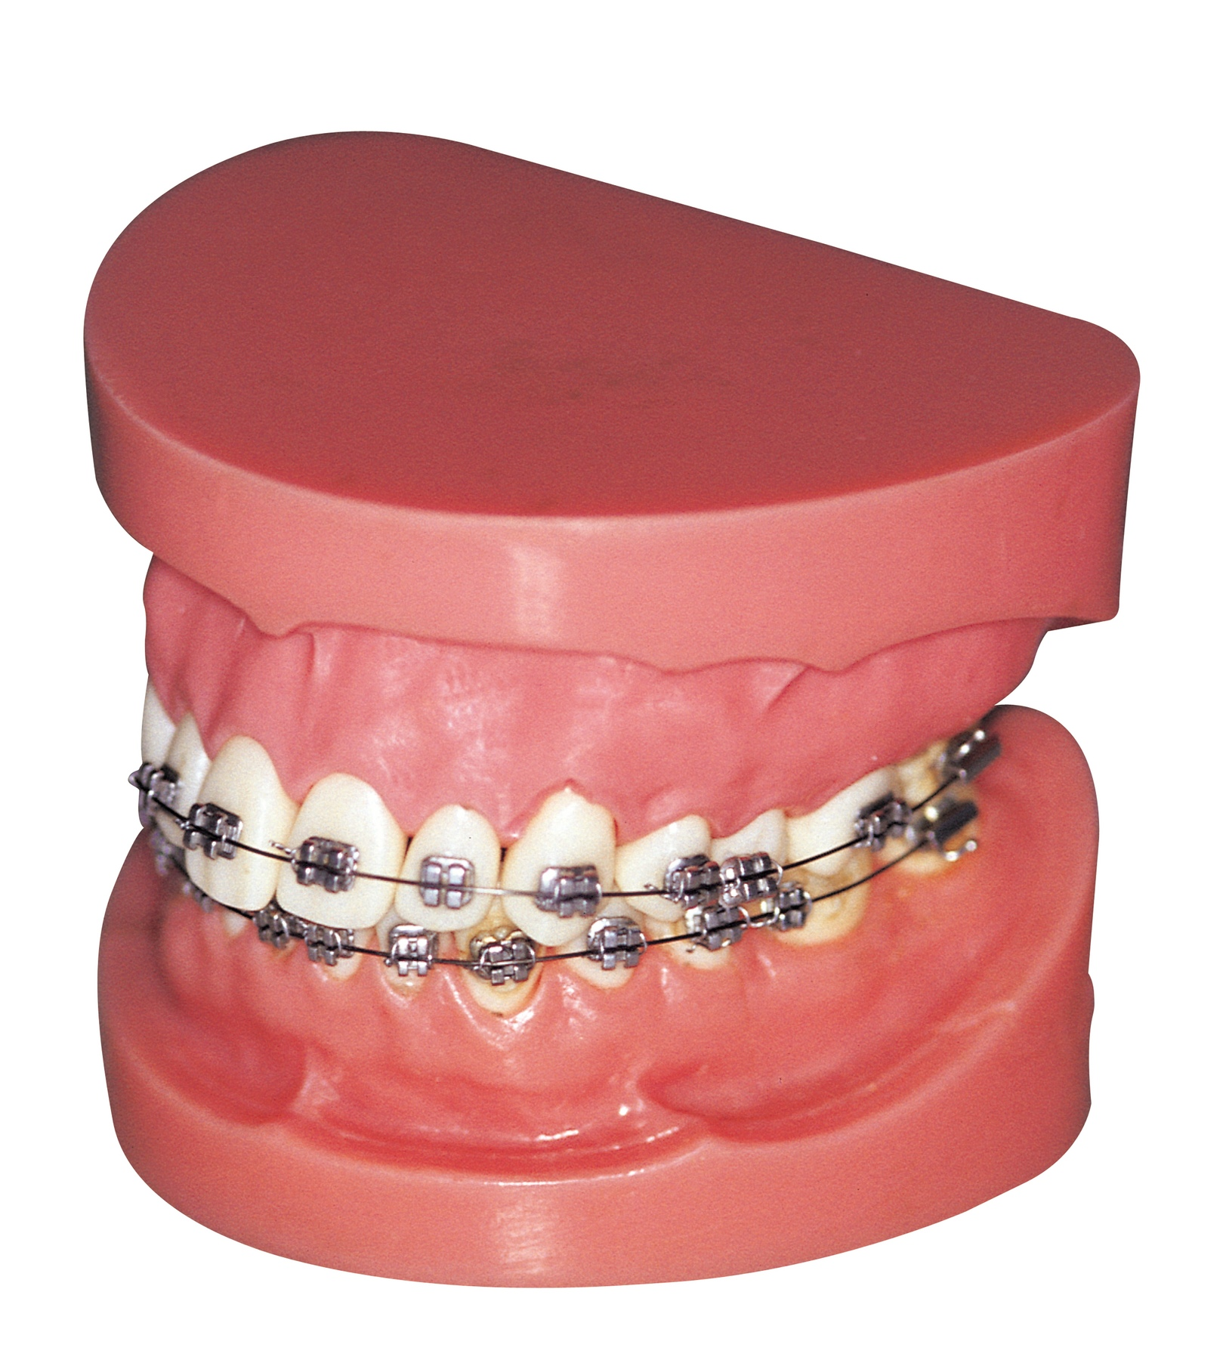
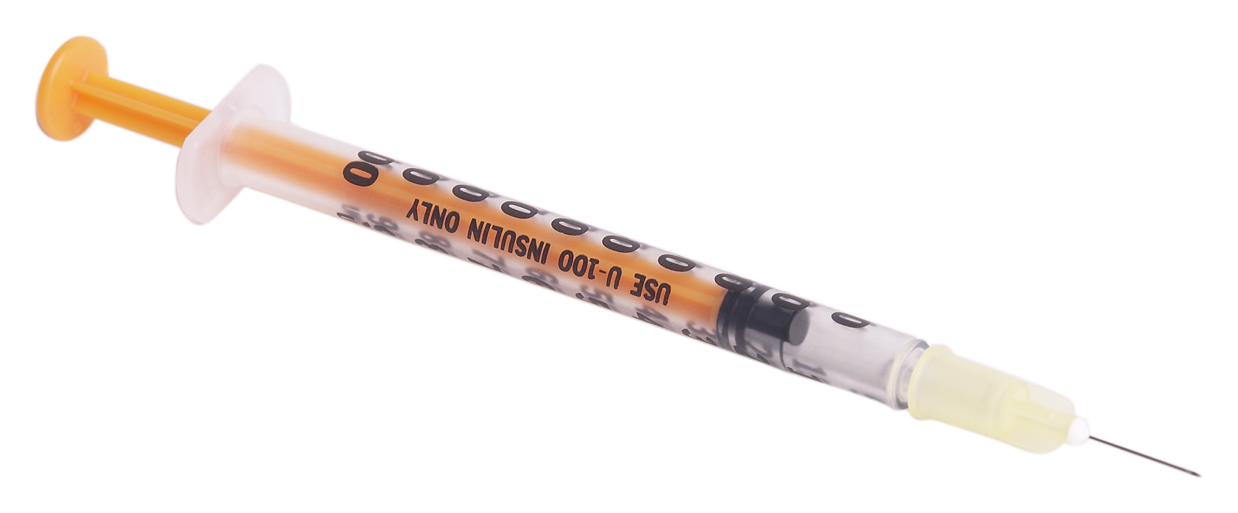
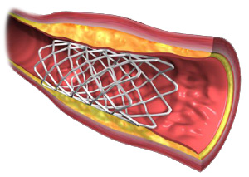
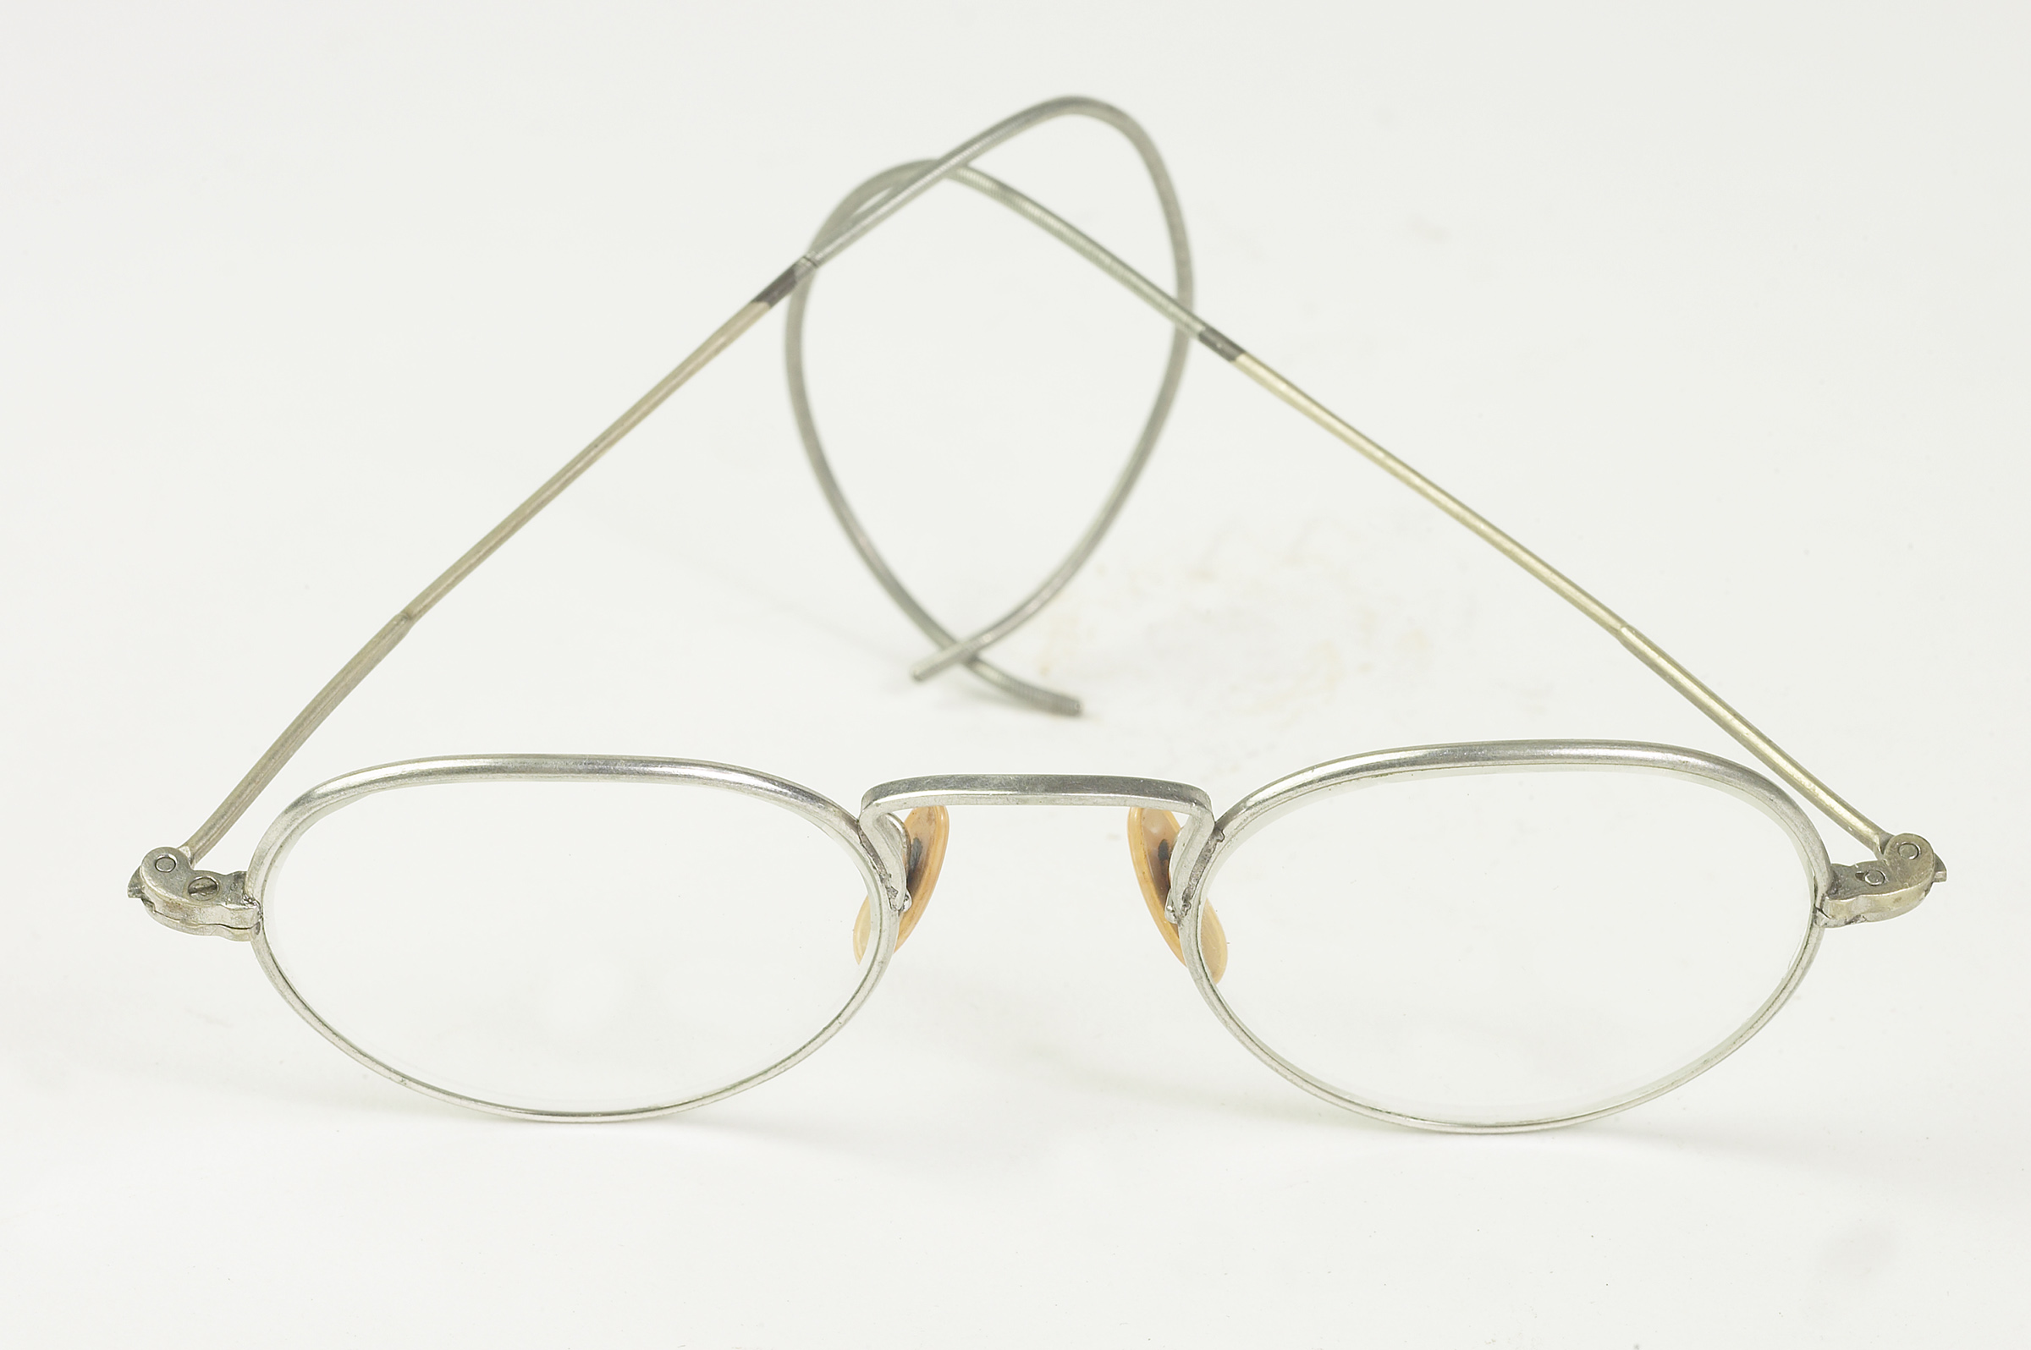
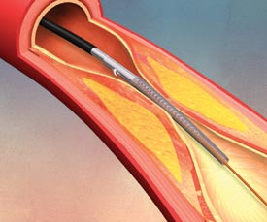
Applications of Nitinol
Needles
Orthodontic devices
Guidewires
Catheters
Stents
Glasses
Notes:
Stent picture from www.endovasc.com
Catheter picture from http://www.mayoclinic.org/checkup-2005/images/pvd-catheter.jpg

Slide 24
So what?
So things change when we look at the nano level, what can you do with it?
In many cases, you are limited only by your imagination!

Slide 25
Imagine it
What if your clothes knew you?
You could develop a fabric that senses you are hot and keeps you cool in the summer. The same material could sense you are cold, but keep you warm in the winter?

Slide 26
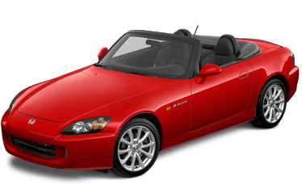
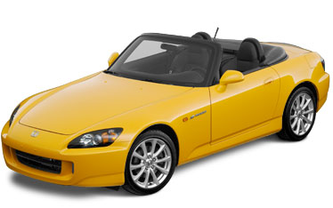
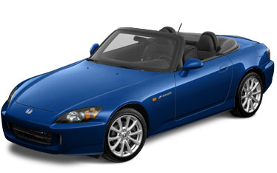
Imagine it
What if your car’s color could change with your mood?
Nano particles in paint can respond to electric fields to change color

Slide 27
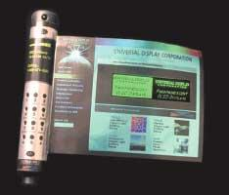
Imagine it
What if you could develop electronics that could roll up and fit in your pocket?

