Slide 1
Symbiosis
Definition: The close relationship that exists when 2 or more species live together.

Slide 2
KEY
+ = Good
- = Bad
0 = No Effect

Slide 3
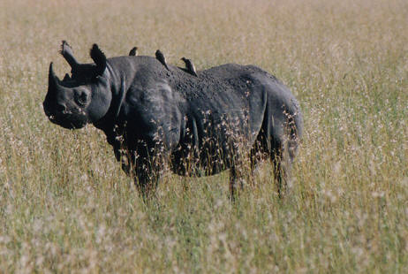
Mutualism
+ +
Ex) Birds eating bugs off of a Rhino.

Slide 4
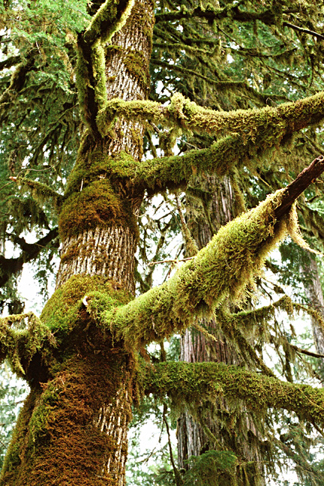
Commensalism
+ 0
Ex) Green moss growing on trees.

Slide 5
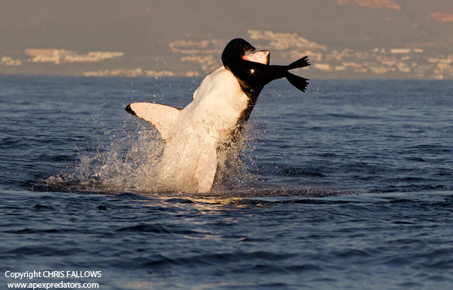
Predation
+ -
Ex) A shark attacking a walrus for a meal.

Slide 6
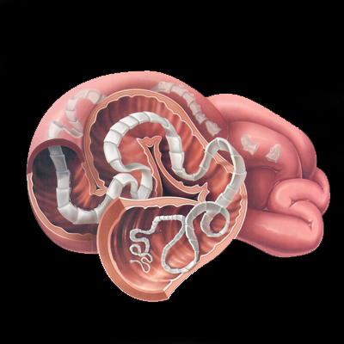
Parasitism
+ -
Ex) a tape worm living off of its host.

Slide 7
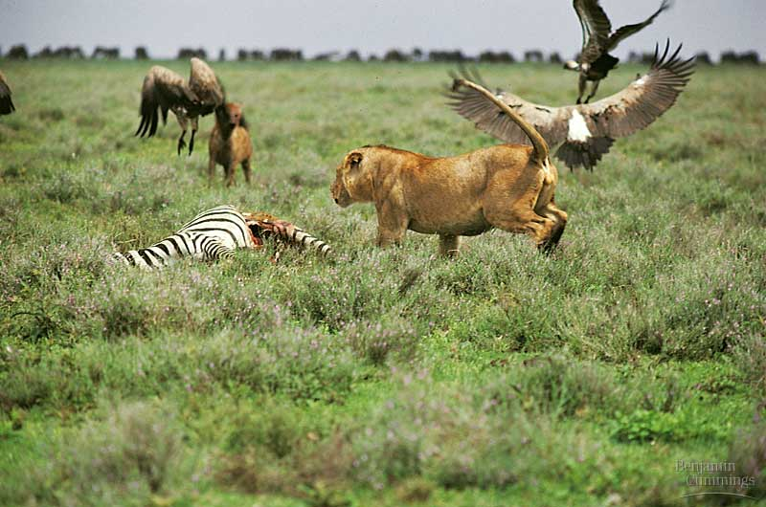
Competition
- -
Ex) 2 species fighting over a meal.

